Slide 1
signed edges and balanced networks

Slide 2
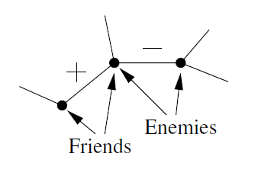

Signed Graphs
Definition. In a signed graph, each edge is labeled with one of the two signs, either $+$ or $−$, where
$+$ represents a positive relationship (friendship);
$−$ represents a negative relationship (antagonism).

Slide 3
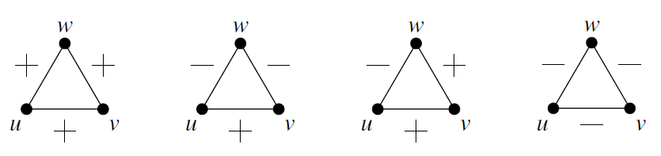
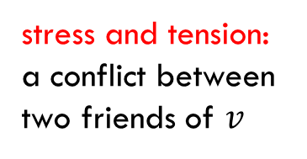
Four Types of Triangles
In a signed graph, there are four possible variants of triangles:
stable situation: three mutual friends
stable situation: two friends have a mutual enemy
stress and tension: a conflict between two friends of $v$
stress and tension: any two people are motivated to “team up” against the third

Slide 4
Balanced and Unbalanced Triangles
Since unbalanced triangles are sources of stress and tension, people strive to minimize them in their personal relationships.
balanced triangles
unbalanced triangles

Slide 5

Structural Balance Property
Definition. If $G$ is a signed graph where every triangle is balanced, we say that $G$ a balanced graph. We also say that $G$ has the structural balance property.
Examples

Slide 6
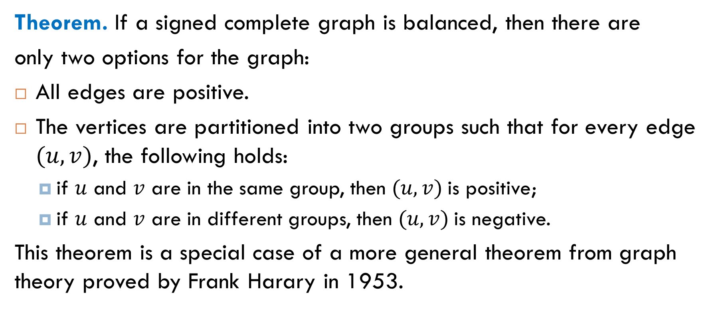
The Balance Theorem
Theorem. If a signed complete graph is balanced, then there are
only two options for the graph:
All edges are positive.
The vertices are partitioned into two groups such that for every edge $(u,v)$, the following holds:
if $u$ and $v$ are in the same group, then $(u,v)$is positive;
if $u$ and $v$ are in different groups, then $(u,v)$is negative.
This theorem is a special case of a more general theorem from graph theory proved by Frank Harary in 1953.

Slide 7
Illustration

Slide 8
Proof

Slide 9
Extensions to the Model
Weakly balanced graphs
Arbitrary (not necessarily complete) graphs
Approximately balanced graphs

Slide 10

Only One Unbalanced Triangle
Observation from psychology. In unbalanced triangles with three minuses, two nodes typically will ally themselves against the third. Therefore, a latent source of stress in unbalanced triangles with two pluses and one minus is stronger than in the case of three minuses. What can we say about networks where only triangles with two pluses and one minus are considered to be unbalanced?
unbalanced

Slide 11
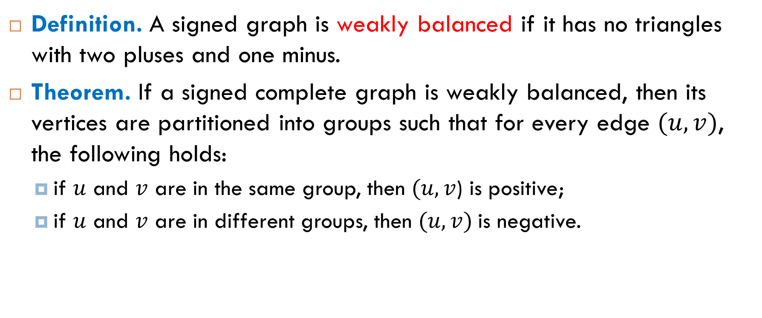
Weakly Balanced Graphs
Definition. A signed graph is weakly balanced if it has no triangles with two pluses and one minus.
Theorem. If a signed complete graph is weakly balanced, then its vertices are partitioned into groups such that for every edge $(u,v)$, the following holds:
if $u$ and $v$ are in the same group, then $(u,v$) is positive;
if $u$ and $v$ are in different groups, then $(u,v)$is negative.

Slide 12
Illustration

Slide 13
Proof
The same idea as in the proof of the Balance Theorem:

Slide 14
Balance for Arbitrary Graphs
The problem is how to define “balance” for arbitrary signed graphs like that:

Slide 15
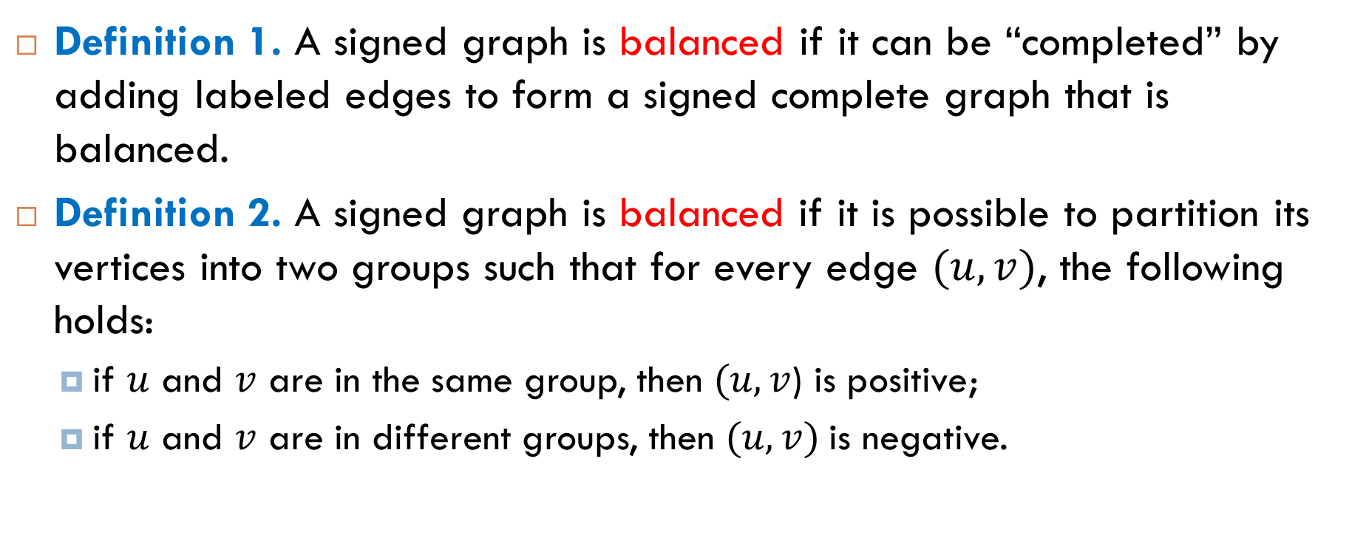
Two Equivalent Definitions
Definition 1. A signed graph is balanced if it can be “completed” by adding labeled edges to form a signed complete graph that is balanced.
Definition 2. A signed graph is balanced if it is possible to partition its vertices into two groups such that for every edge $(u,v)$, the following holds:
if $u$ and $v$ are in the same group, then $(u,v$) is positive;
if $u$ and $v$ are in different groups, then $(u,v)$is negative.

Slide 16
Characterization of Balanced Graphs
Question. Is it possible to determine efficiently whether a given signed graph is balanced or not?
Theorem (Harary). A signed graph is balanced if and only if it contains no cycle with an odd number of negative edges.
Idea of proof

Slide 17
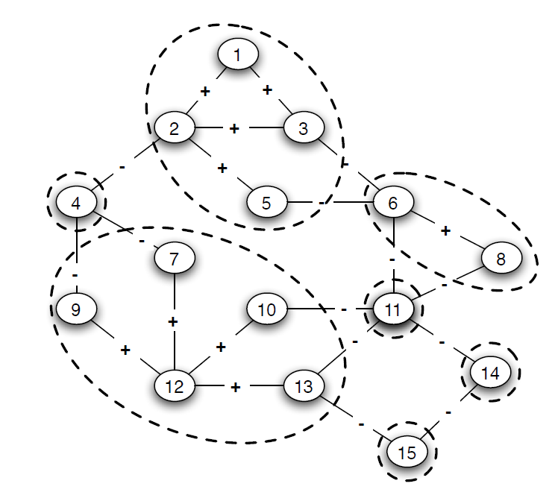
Testing for Balance
To determine if a signed graph is balanced, the first step is to consider only the positive edges, to find the connected components. Each such component can be replaced with a super-node. Then it remains to check whether there is a cycle of odd length in the resulting super-graph.

Slide 18
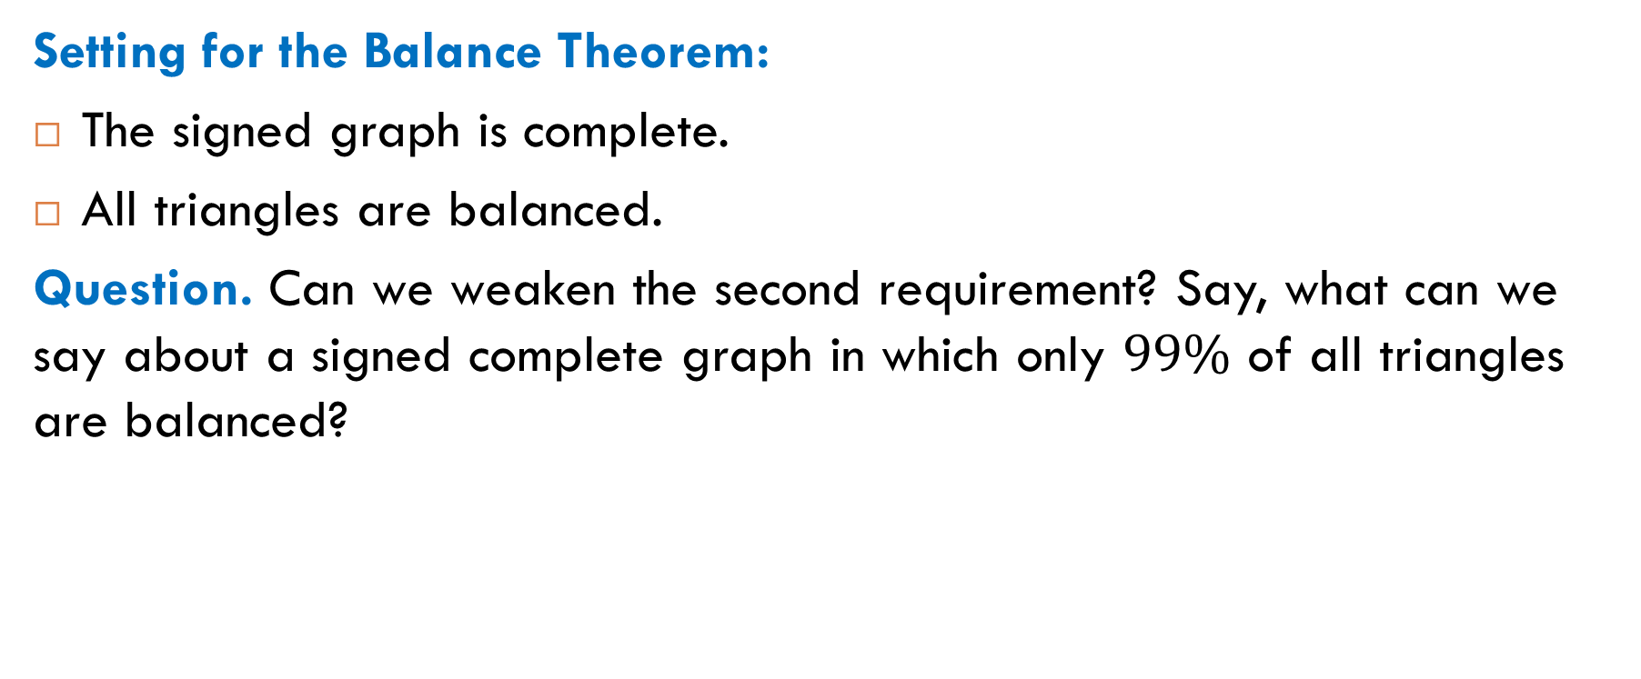
Approximate Balance
Setting for the Balance Theorem:
The signed graph is complete.
All triangles are balanced.
Question. Can we weaken the second requirement? Say, what can we say about a signed complete graph in which only $99\%$ of all triangles are balanced?

Slide 19
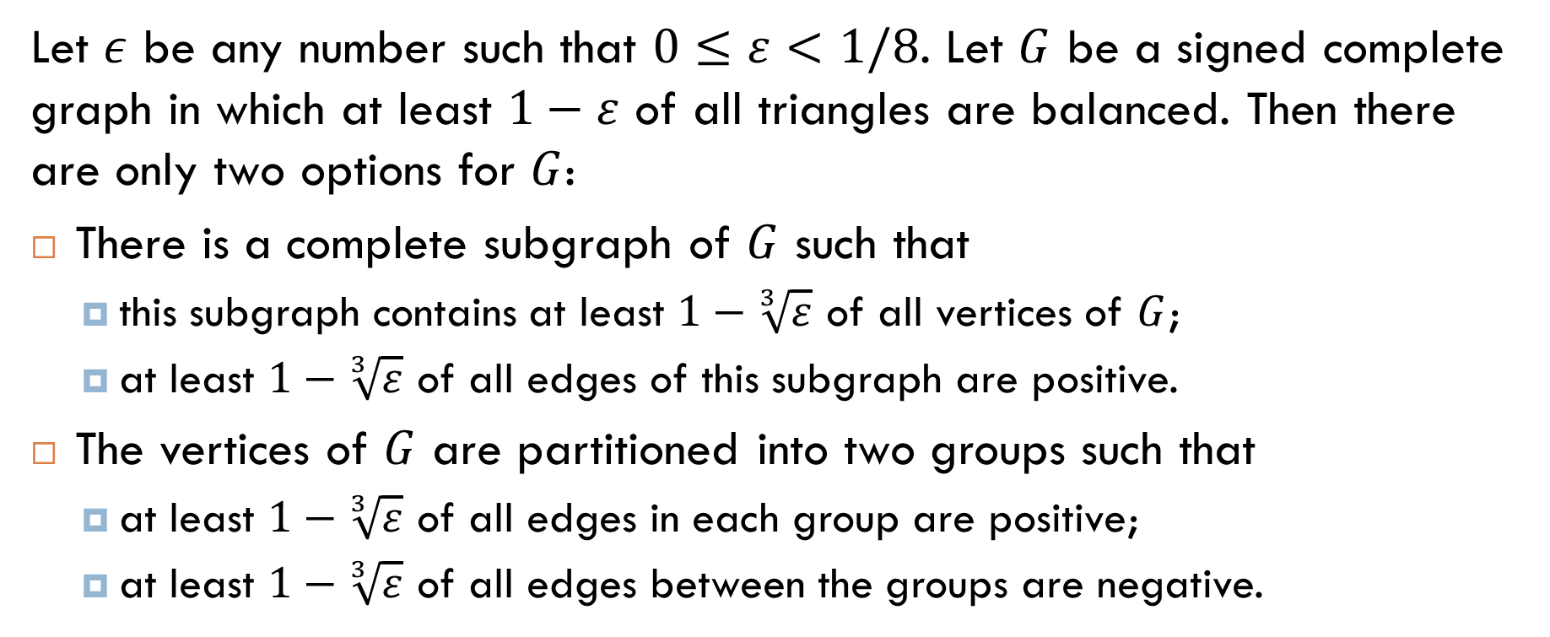
Theorem
Let $ε$ be any number such that $0≤ε<1/8$. Let $G$ be a signed complete graph in which at least $1−ε$ of all triangles are balanced. Then there are only two options for $G$:
There is a complete subgraph of $G$ such that
this subgraph contains at least $1−\sqrt[3]{ε}$ of all vertices of $G$;
at least $1−\sqrt[3]{ε}$ of all edges of this subgraph are positive.
The vertices of $G$ are partitioned into two groups such that
at least $1−\sqrt[3]{ε}$ of all edges in each group are positive;
at least $1−\sqrt[3]{ε}$ of all edges between the groups are negative.

Slide 20
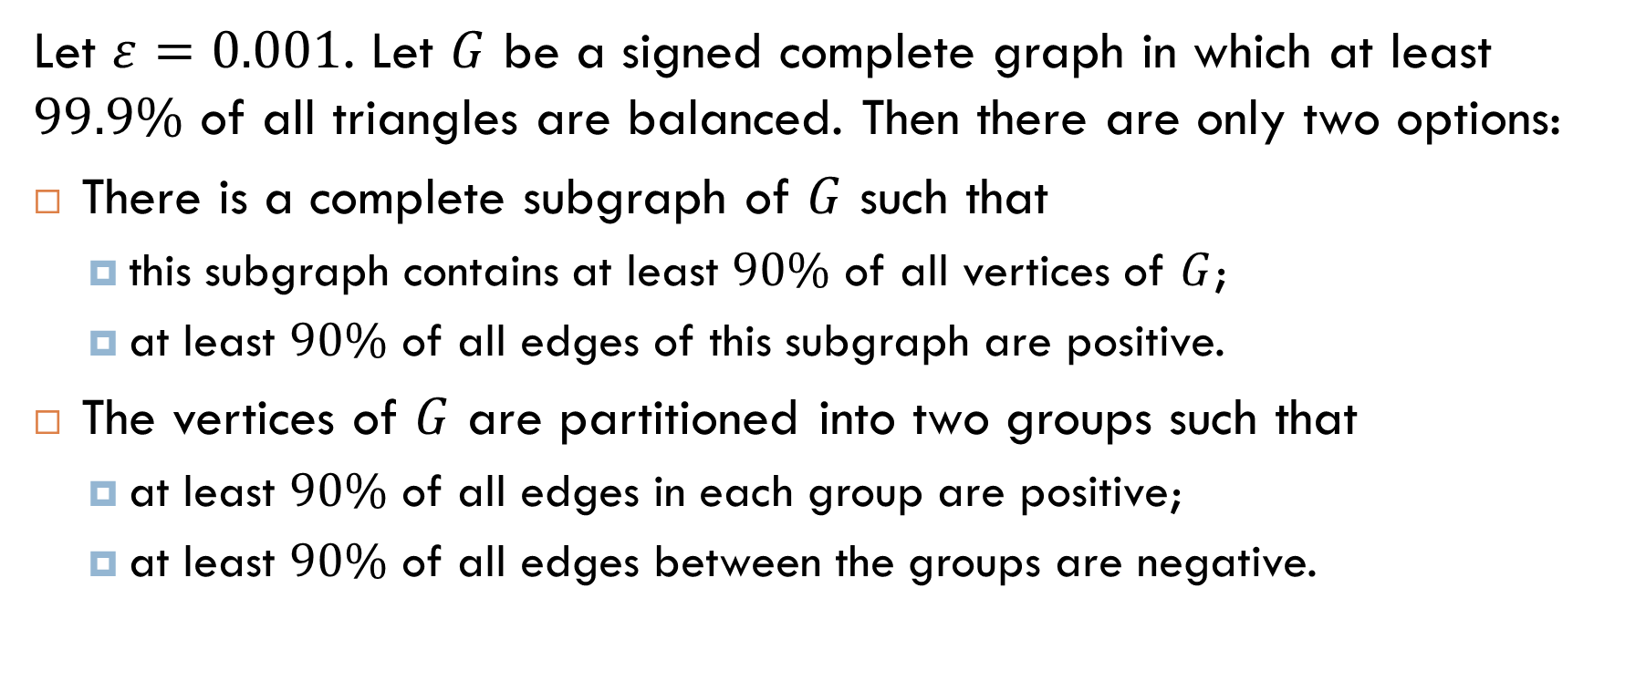
Example
Let $ε=0.001$. Let $G$ be a signed complete graph in which at least $99.9\%$ of all triangles are balanced. Then there are only two options:
There is a complete subgraph of $G$ such that
this subgraph contains at least $90\%$ of all vertices of $G$;
at least $90\%$ of all edges of this subgraph are positive.
The vertices of $G$ are partitioned into two groups such that
at least $90\%$ of all edges in each group are positive;
at least $90\%$ of all edges between the groups are negative.

Slide 21

Reading
Section 7.5

